Slide 1
Node-RED
Hands-on Exercise

Slide 2
What is Node-RED?
Node-RED is a programming tool for wiring together hardware devices, APIs and online services in new and interesting ways.
It provides a browser-based editor that makes it easy to wire together flows using the wide range of nodes in the palette that can be deployed to its runtime in a single-click.

Slide 3
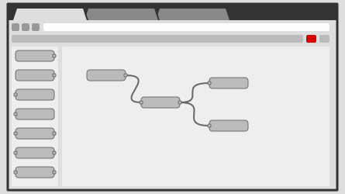
Browser-based flow editing
Node-RED provides a browser-based flow editor that makes it easy to wire together flows using the wide range of nodes in the palette. Flows can be then deployed to the runtime in a single-click.
JavaScript functions can be created within the editor using a rich text editor.
A built-in library allows you to save useful functions, templates or flows for re-use.

Slide 4
FRED – online Node Red
Now, for Node-Red, you can choose to install it on your PC or just use the cloud-based.
Cloud-based is at https://fred.sensetecnic.com/
Node-RED provides a browser-based flow editor, which can be used to create JavaScript functions. The runtime is built on Node.js. The flows created in Node-RED are stored using JSON.
Front End for Node-RED (FRED) manages instances of Node-RED for multiple users in the cloud. To instantly create your own Node-RED instance, register for a free (limited) account, or check out the pricing for hosting your instance of Node-RED.

Slide 5
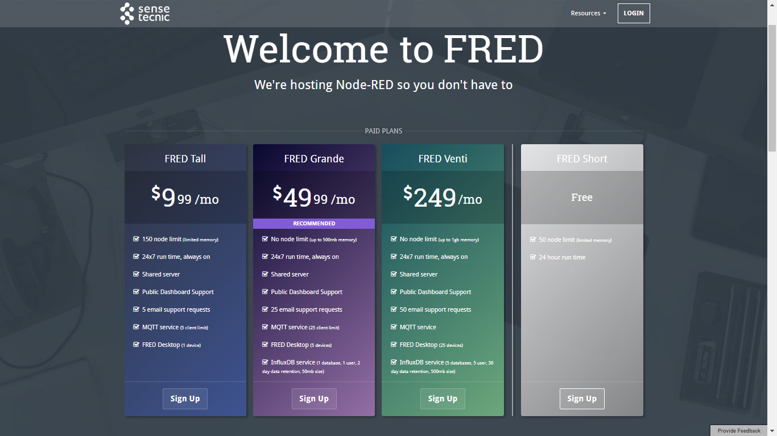
Register FREE with FRED
https://fred.sensetecnic.com

Slide 6
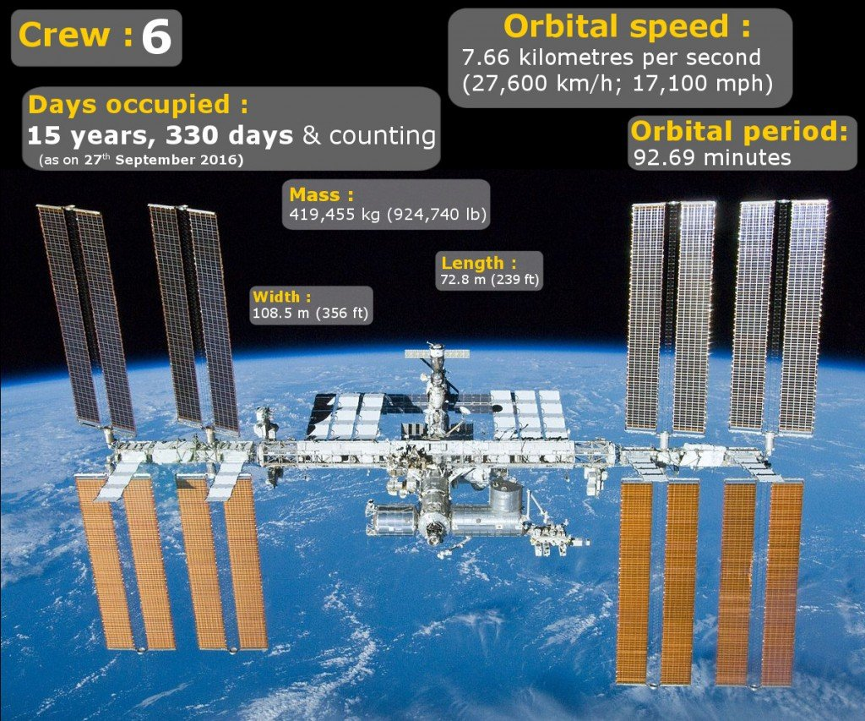

Slide 7
Where is the International Space Station (ISS)?
Exercise: Tracking ISS using Node RED
Latitude and Longitude
Source Wikipedia: The International Space Station (ISS) is a space station, or a habitable artificial satellite, in low Earth orbit. Its first component launched into orbit in 1998, the last pressurised module was fitted in 2011, and the station is expected to operate until 2028. Development and assembly of the station continues, with components scheduled for launch in 2018 and 2019. The ISS is the largest human-made body in low Earth orbit and can often be seen with the naked eye from Earth.^{[8][9]} The ISS consists of pressurised modules, external trusses, solar arrays, and other components. ISS components have been launched by Russian Proton and Soyuz rockets, and American Space Shuttles.^{[10]}

Slide 8
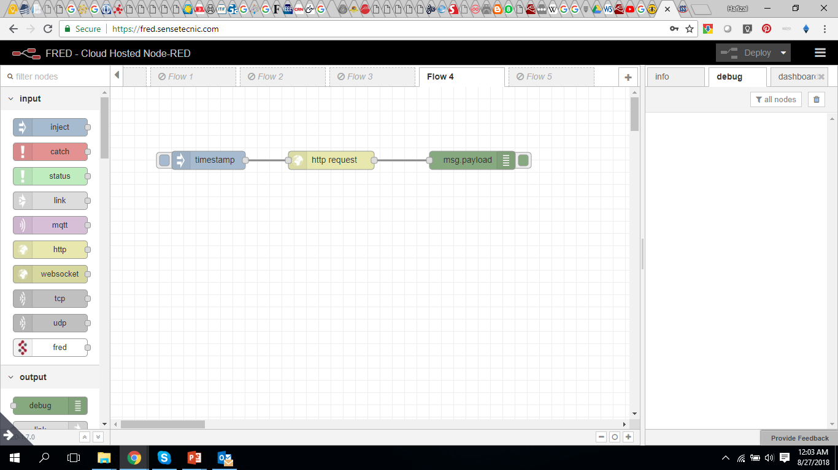
http://api.open-notify.org/iss-now.json

Slide 9
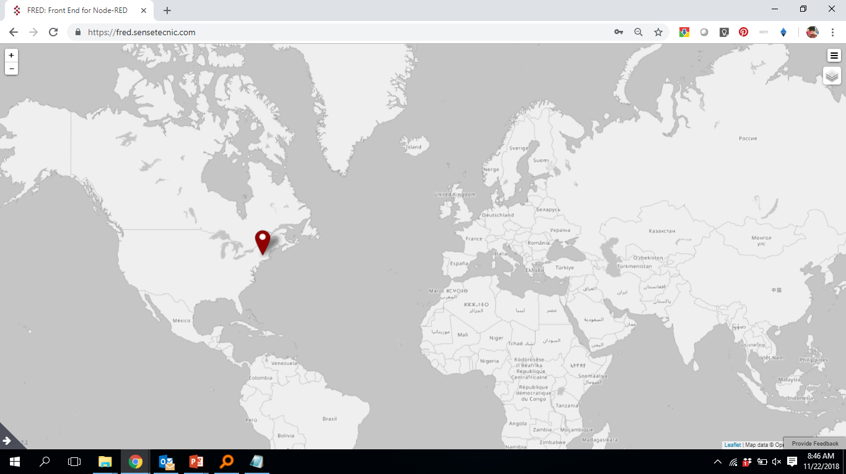
Display on Map?

Slide 10
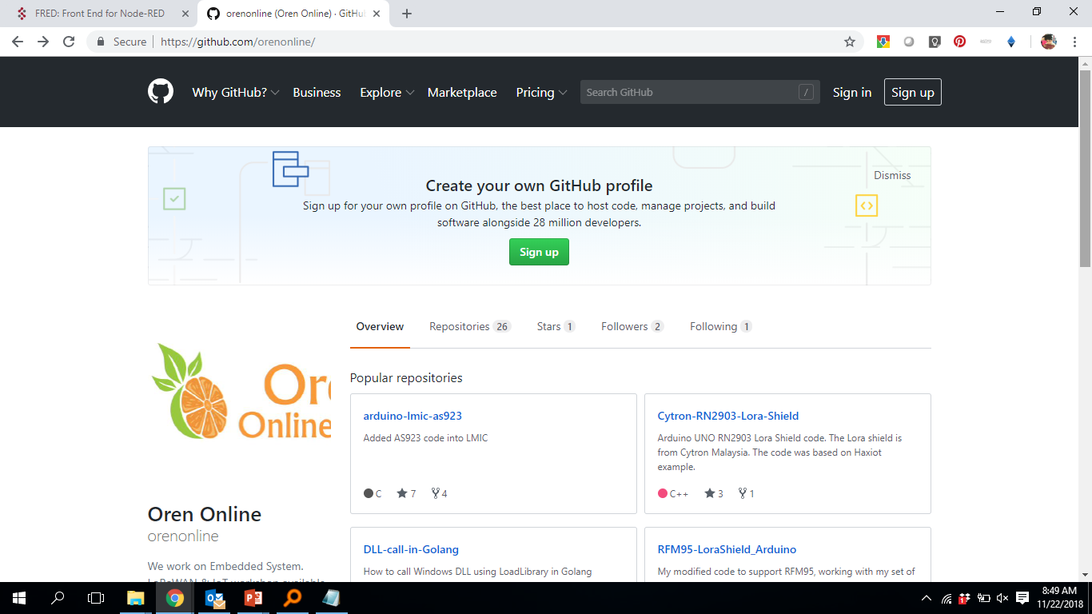
Get the “Flow” from here…
https://github.com/orenonline

Slide 11
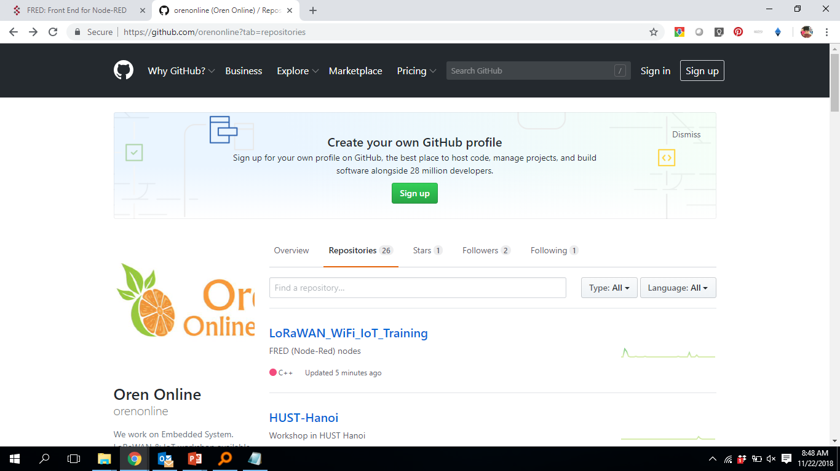
Click on “LoRaWAN_WiFi_IoT_Training”

Slide 12
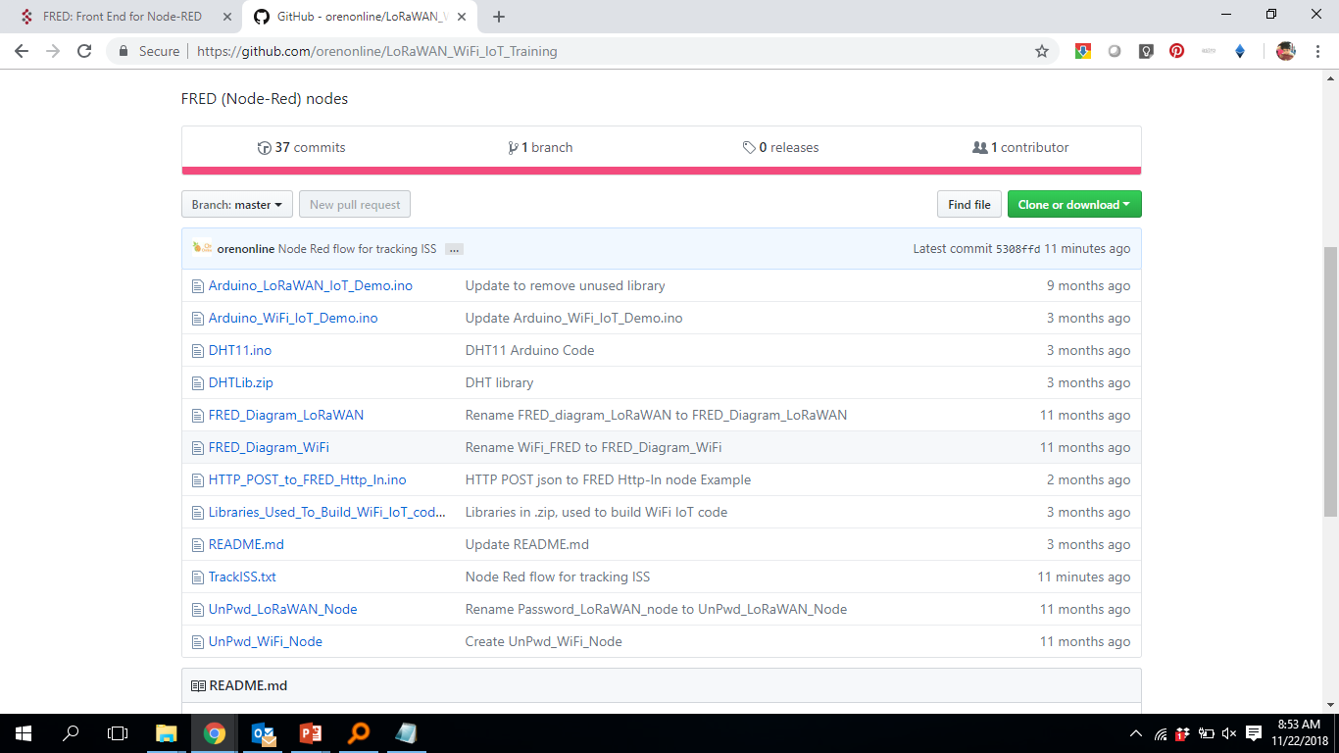
Click on “TrackISS.txt”

Slide 13
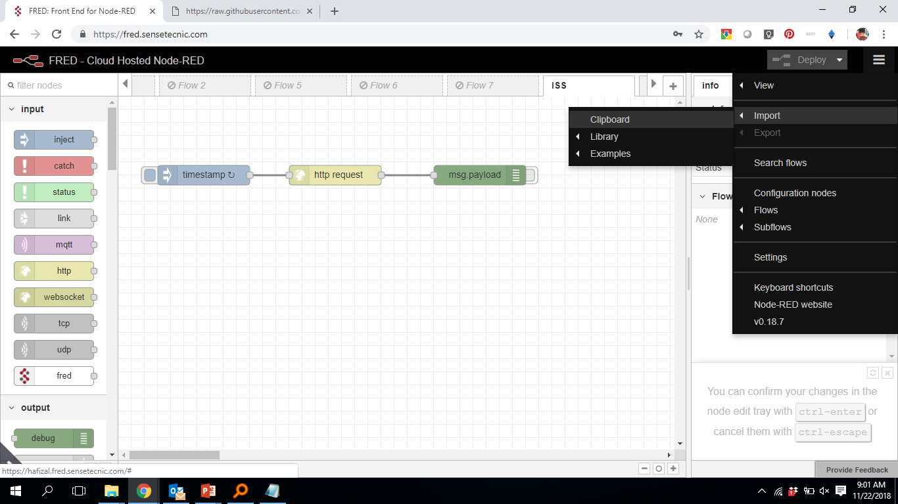
Finally… Import “Flow”

Slide 14
THANK YOU
Any questions?
zaki.bakar@mimos.my
nordin.ramli@mimos.my
hafizal.mohamad@mimos.my

